Slide 1

Bank Loan Status
Group Number: 306
Project Members:
Abhishek Singh(A20447125)
Megha Shrivastava(A20450886)

Slide 2

ABOUT THE PROJECT
Loan Analysis is the method which gives the information whether a person will be able to pay the loan or not.
Sometime the borrowers doesn’t pay the loan so the analysis of whether they are going to pay the loan will be very helpful. In this project, with the help of various models and their analysis we have checked whether a person will be able to pay the loan.
The models in the project are built by considering 19 attributes.

Slide 3

SYSTEM FLOW OF THE PROJECT
DATA COLLECTION
PRE-PROCESSING OF DATA
MODEL SELECTION
KAGGLE
Missing Values, Dummy Variables
BUILDING THE MODEL
RESULT
EVALUATION

Slide 4

DATASET
The dataset was found on Kaggle, containing of approx. 19 columns and 99981 records.
The dataset contains the csv file credit_train.csv which has the independent as well as the dependent variables.
The dataset was found: https://www.kaggle.com/zaurbegiev/my-dataset
From the data, the loan status is considered as the independent variable and remaining all the variables are considered as dependent variable.

Slide 5

DATA UNDERSTANDING
The data consist of 19 attributes which are further classified as qualitative and quantitative data.
From the data, the 6 attributes are Qualitative data and 13 attributes are Quantitative data.
Also, the data is converted according to the requirement of the model.

Slide 6


MODELLING AND ANALYSIS DONE IN OUR PROJECT
We have created mainly the two models namely:
  K – Nearest Neighbors (KNN) model
  Logistic Regression Model
  Gradient Boosting

Slide 7
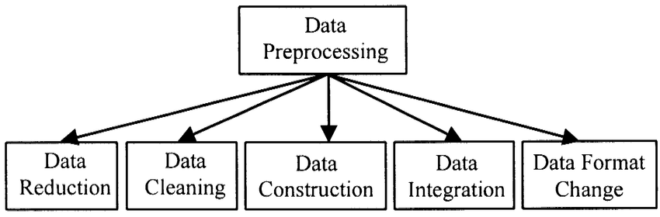
DATA PREPROCESSING
To find the missing values and removing them.
To create dummy variables.

Slide 8
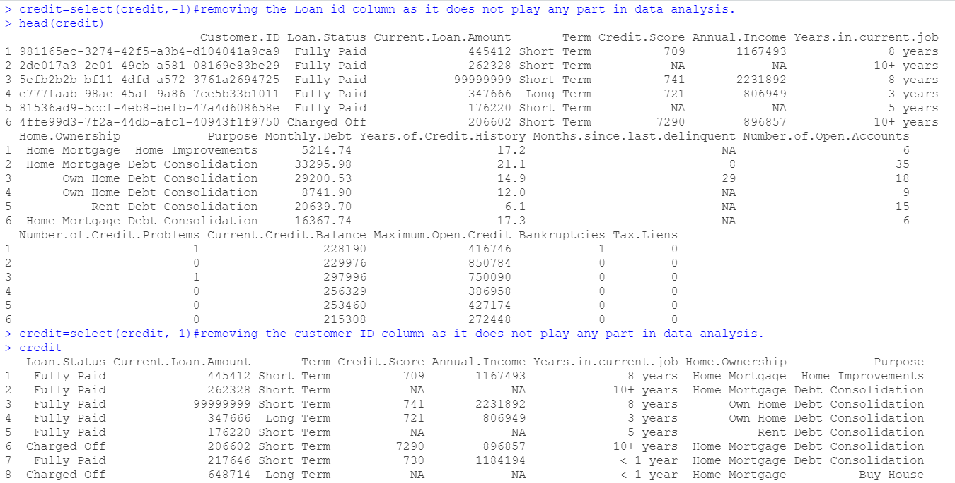
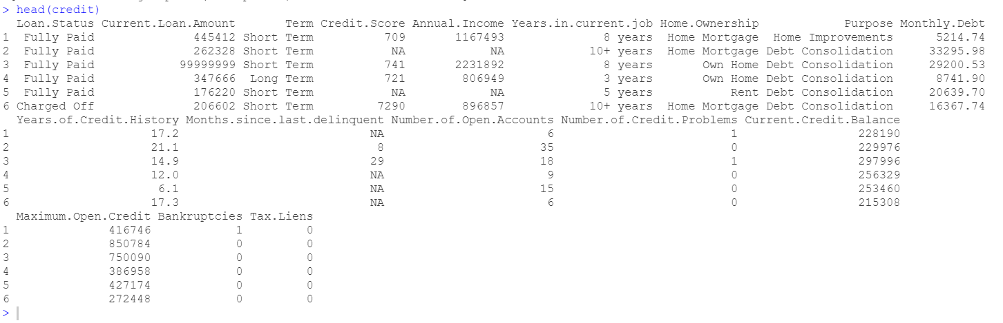
Data Cleaning

Slide 9
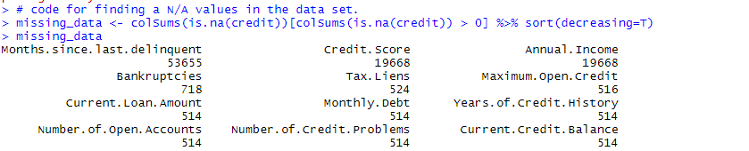
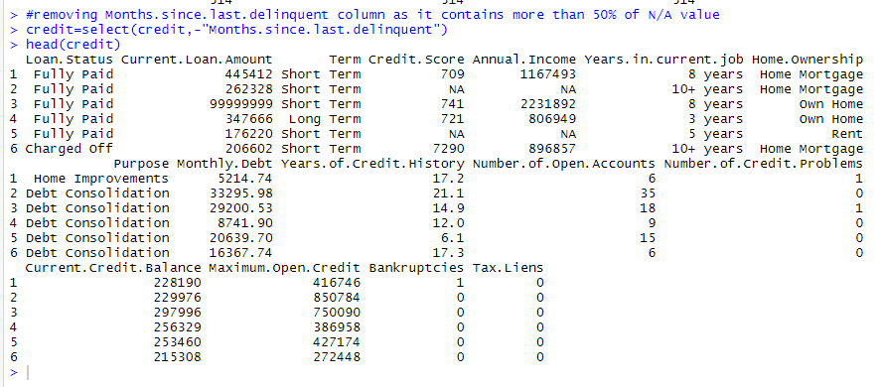
Data Cleaning

Slide 10
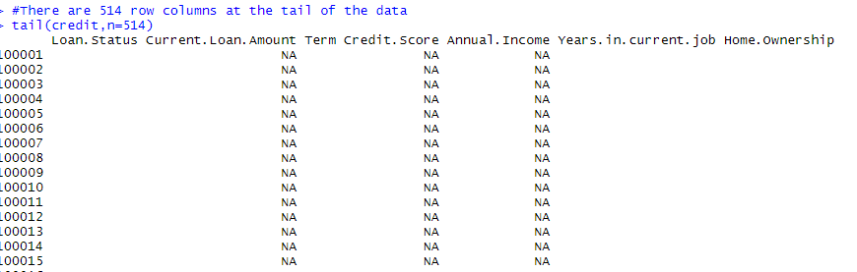
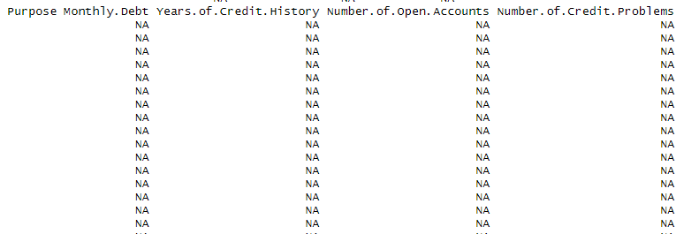
Data Cleaning

Slide 11
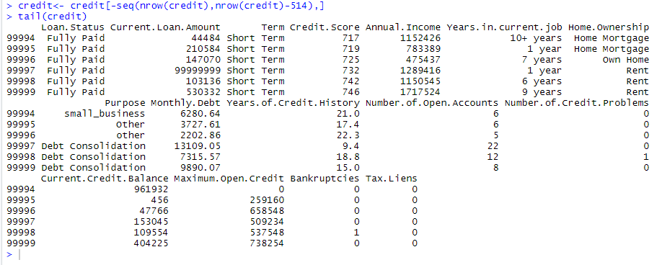
Data Cleaning

Slide 12
Data Cleaning

Slide 13
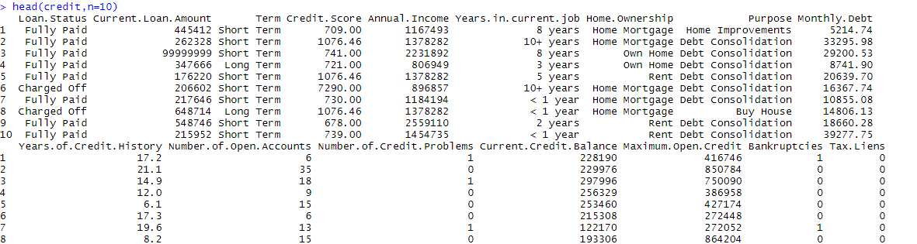
Data Cleaning

Slide 14
K-Nearest Neighbor Model
The KNN models are generally simple and can be used in both classification as well as regression model.
We need to Normalize our data before calculating the distance.
In KNN, the distance is calculated on the basis of similarity of the data. The distance calculation method commonly used are:
  Manhattan distance
  Euclidean distance

Slide 15
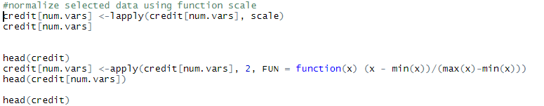
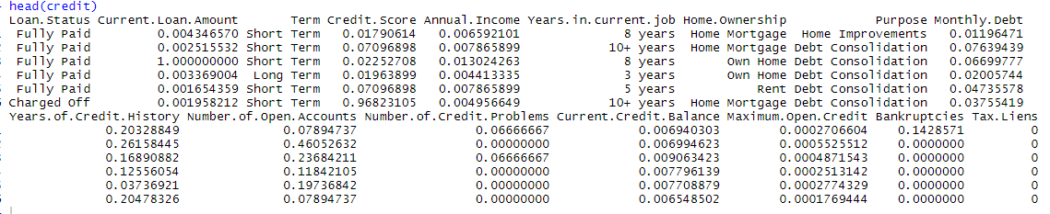
KNN: Normalization

Slide 16
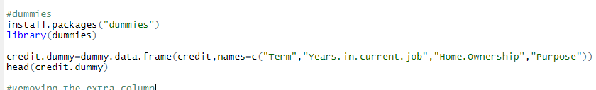
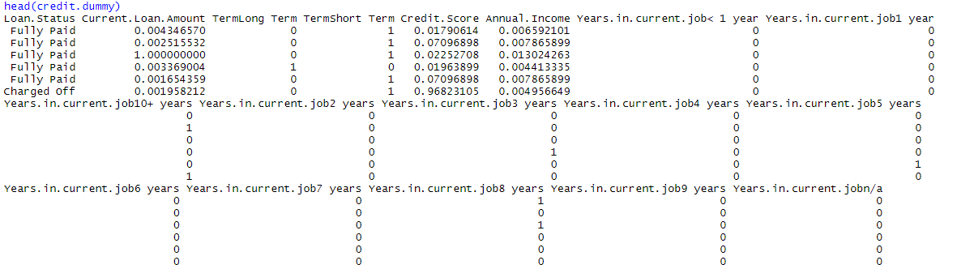
KNN: Creating Dummies

Slide 17
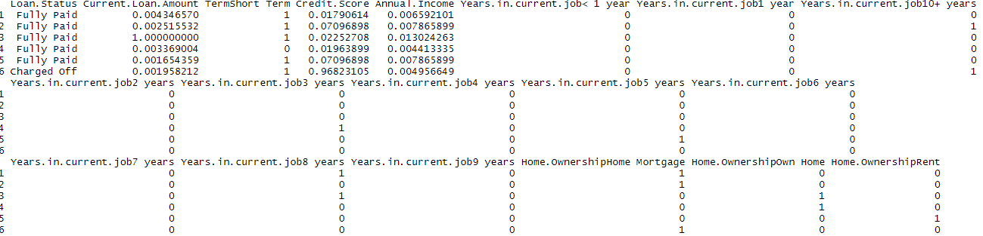
KNN: Removing the extra column

Slide 18
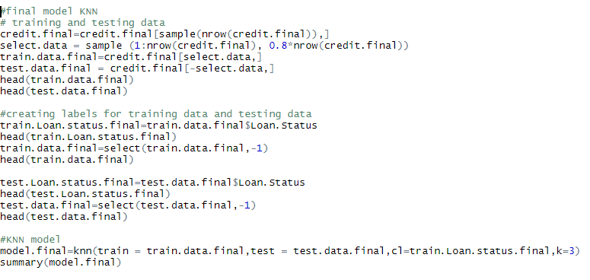
KNN: Model

Slide 19
KNN: Model Summary

Slide 20

KNN: Accuracy of the Model

Slide 21
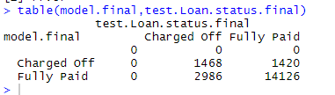
KNN: Confusion Matrics

Slide 22
Logistic Regression Model
Logistic Regression is the statistical based model which is used for classifications.
The logistic regression model is used to predict the nominal values.
Logistic regression calculates the probability using log(odds)

Slide 23
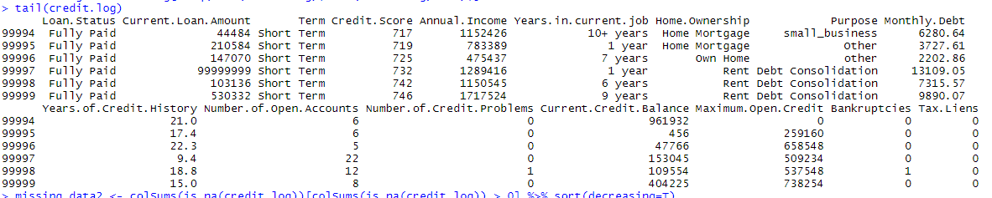
Logistic Regression Model: Data set

Slide 24
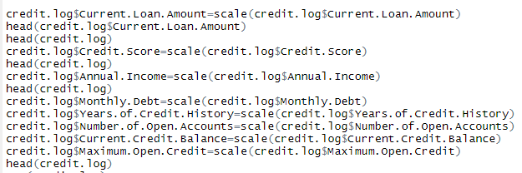
Logistic Regression Model: Scaling

Slide 25
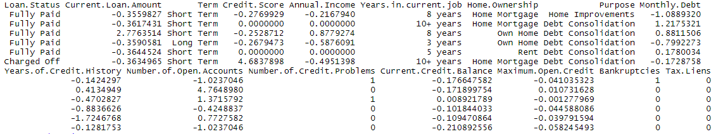
Logistic Regression Model: Scaling

Slide 26
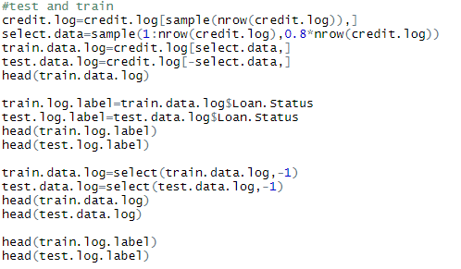
Logistic Regression : Training and testing the data.

Slide 27
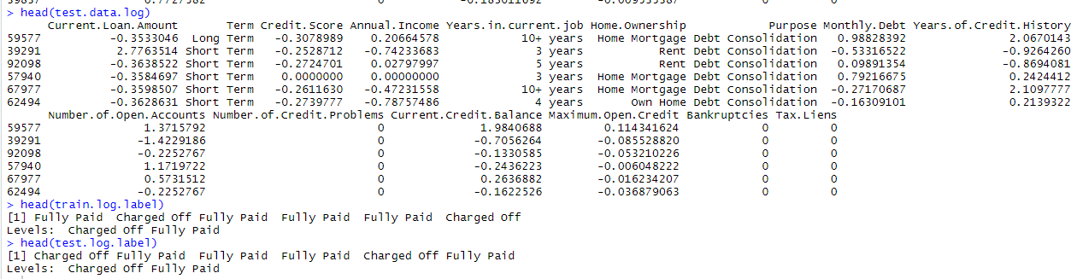
Logistic Regression: Training and Testing the data

Slide 28
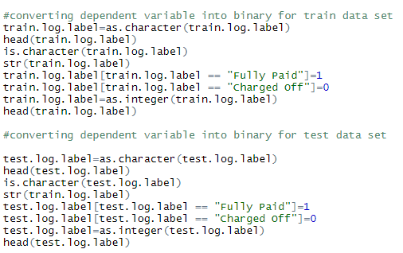
Logistic Regression: Converting the dependent variable into binary.

Slide 29
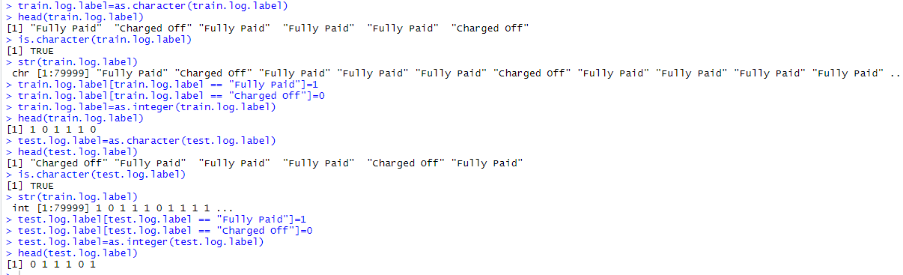
Logistic Regression: Converting the dependent variable into binary.

Slide 30
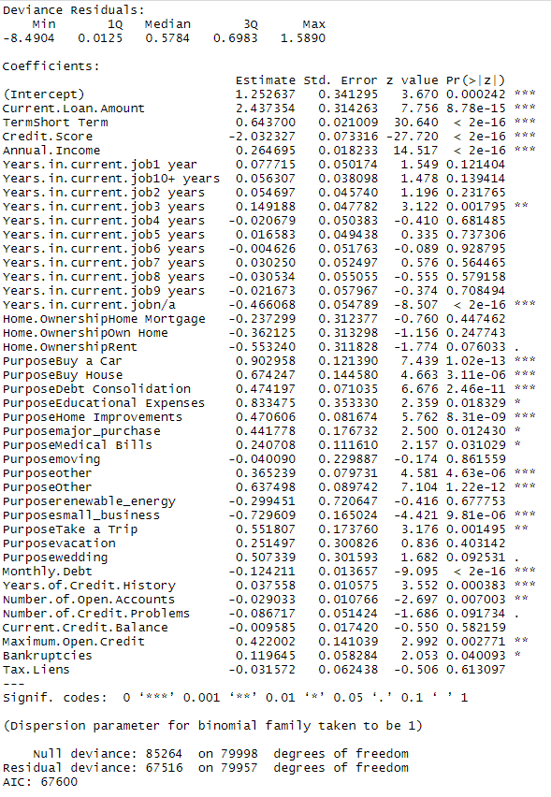

Logistic Regression: Model

Slide 31
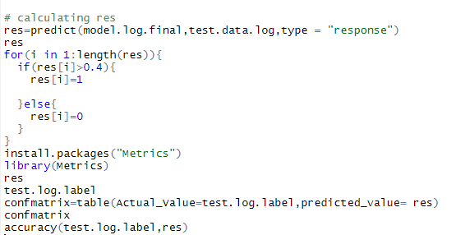
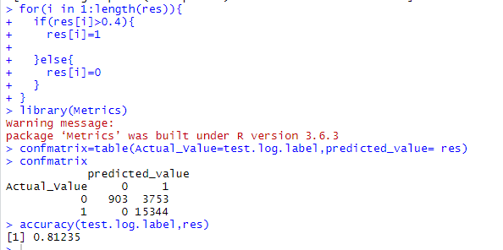
Logistic Regression: Res & Accuracy Calculation

Slide 32
Gradient Boosting Model
The Gradient boosting is the technique which is used for regression and classification.
It produces a prediction model, the most common one is the decision tree.

Slide 33
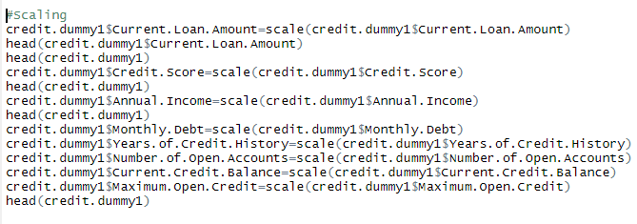
Gradient Boosting: Scaling

Slide 34
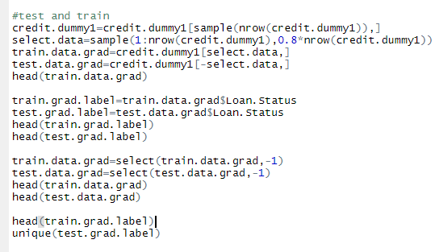
Gradient Boosting: Testing and Training.

Slide 35
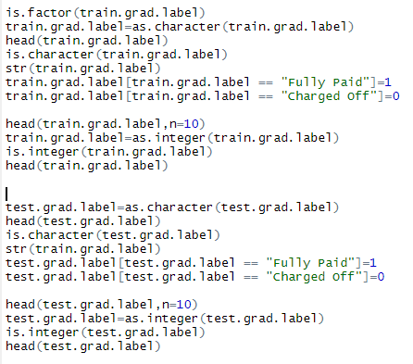
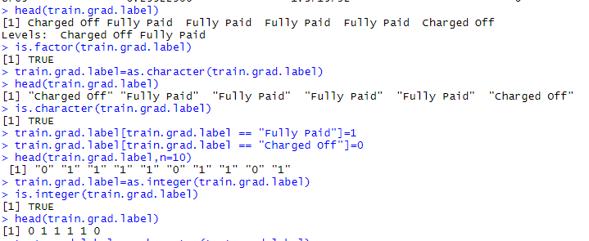
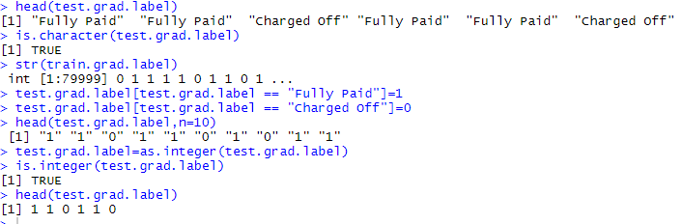
Gradient Boosting: Converting the Dependent Variable into Binary

Slide 36
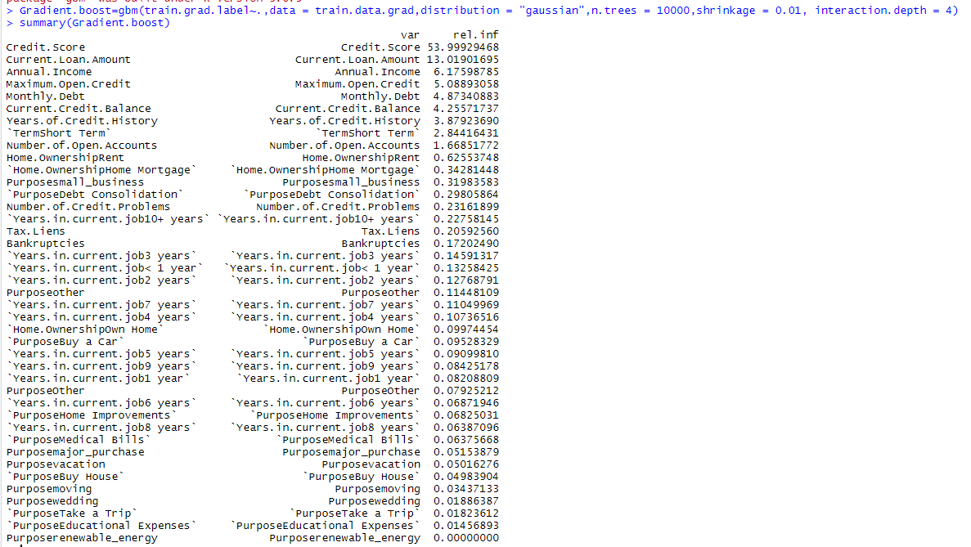
Gradient Boosting: Model

Slide 37
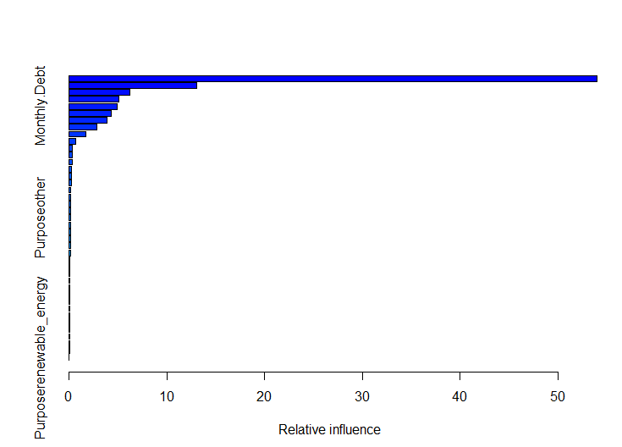
Gradient Boosting: Model

Slide 38

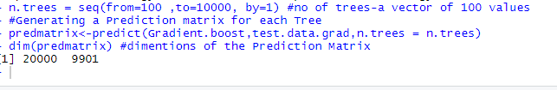
Gradient Boosting: Prediction Metrics

Slide 39
Gradient Boosting: Test Errors

Slide 40
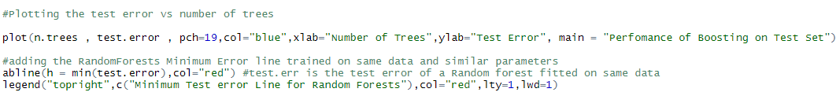
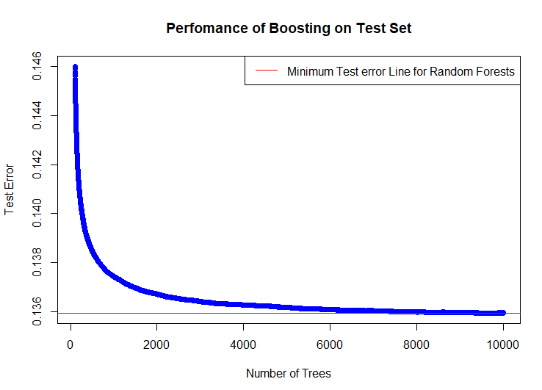
Gradient Boosting: Graph

Slide 41
Gradient Boosting: Accuracy
As the test error value for gradient boosting is 0.135.
The accuracy of the model is 1- test error. So the accuracy is 0.865.
Therefore the accuracy is 86.5%.

Slide 42
Which Model is Best?
Accuracy of KNN Model is 77.97%.
Accuracy of Logistic Regression Model is 81.235%.
Accuracy of Gradient Boosting Algorithm is 86.5%.
So, the best model for data set is Gradient Boosting.

Slide 43
CONCLUSION
We understood various cleaning technique to clean our data. Also, how to normalize our data and creating dummy variables which will be needed for different models.
We understood how vector scaling can be used to regularize our data. This was done to converge the model fast.
We Created different models and understood there pros and cons.
By calculating the accuracy of all the models and creating Confusion Metrics. We predicted which model is best for our data set.

Slide 44


